Slide 1
Chapter -3 Researching Technical Subjects-
Research literally means to search again to find out something new/different and more about a phenomenon.
Your main source of information people so it is necessary to expand your range of research skills using methods as interviewing and surveying.
There are primary and secondary sources of collecting data for research.

Slide 2
Three GENERAL steps of research
  Pose a question.
  Collect data
  Present an answer to the question.

Slide 3
Primary Research: Interviewing
For technical communicators documenting a new product or system, a key information source is the developers themselves.
Data is gathered through interviews with individuals, who are asked specific questions about the product or system.
The information obtained is used to create the process or reference manual.
There are three stages to completing a successful interview:
Preparing for it
Conducting it
Writing it up

Slide 4
Preparing for the interview
1. Learn in advance about the subject/issue to be discussed with the subject matter expert: need of technical knowledge, purpose of the product/system, purpose of writing document
2. Learn in advance about the subject matter expert: interest, specialties, personality, motivate to cooperate with you

Slide 5
3. Prepare a list of organized questions
Organize ahead: before interview schedule organize list of questions
Create a legible/readable, numbered list: jot down questions in order and cross off after being answered
Structure the questions to control the interview: order them general to specific, logical way to cover necessary aspects of subject
Write extra questions: as per the requirement of interview

Slide 6
Writing good questions
Ask about topics that you don’t understand
Good question start with:(5w+ h) who, what, where, when, why, how
Include detail and background to your questions to provide context
Instead of yes, no question ask questions that require explanation.

Slide 7
Conducting the Interview
Schedule an hour-long interview, if possible: contact subject matter expert
Introduce yourself and explain your project: with subject matter expert, tell about your credentials and necessary information
Decide whether to record the interview: interviewee’s permission for recording
Be an active listener: to rephrase, ensure accuracy, fell interviewee that you are interested and engaged
Control the interview: to make clear user about how to use the device, need of technical detail from expert
Working with those for whom English is a second language: if expert is not good in English rephrase questions to locate vocabulary

Slide 8
Closing the Interview
Thank your interviewee for their time and clearly express that their answers have supplied valuable information.
Ensure your subject expert addresses any follow-up questions that may arise during your note review or converting responses into written text.
As soon as you can, review your notes and fill out any gaps that you see with details.
Assess how well the received answers will be sufficient for required information.

Slide 9
Primary research: Conducting surveys
Survey research is a method of generating information by asking questions to a group of people.
Motivate to participate in survey/Need of fund to give participants
Survey research can help you at two stages in your writing project: before you begin writing and as part of usability testing (revising).
In the initial stages of writing project, you could do surveys to find out what users are looking for in a manual.

Slide 10
Asking good questions
The quality of your survey is directly related to your skill at asking good questions.
There are two main types of questions to ask: closed-ended and open-ended.
Closed-ended questions have the range of possible answers printed below the question itself; these questions are said to be closed because the range of answer is predetermined.

Slide 11
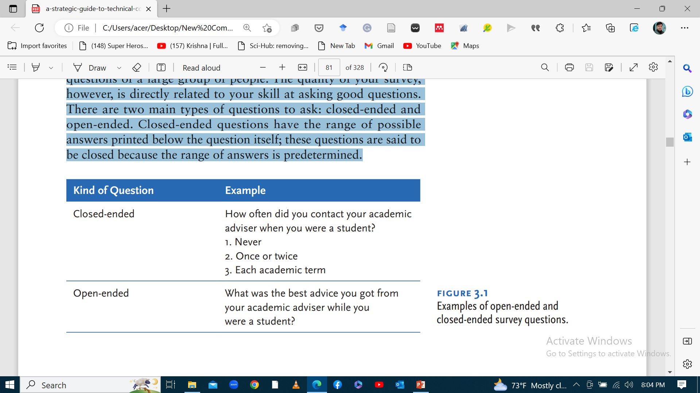

Slide 12
Guidelines for asking good questions
Rephrase jargon and technical language into plain language.
Ask specific questions.
Avoid loaded questions.
Break compound questions into individual questions.

Slide 13
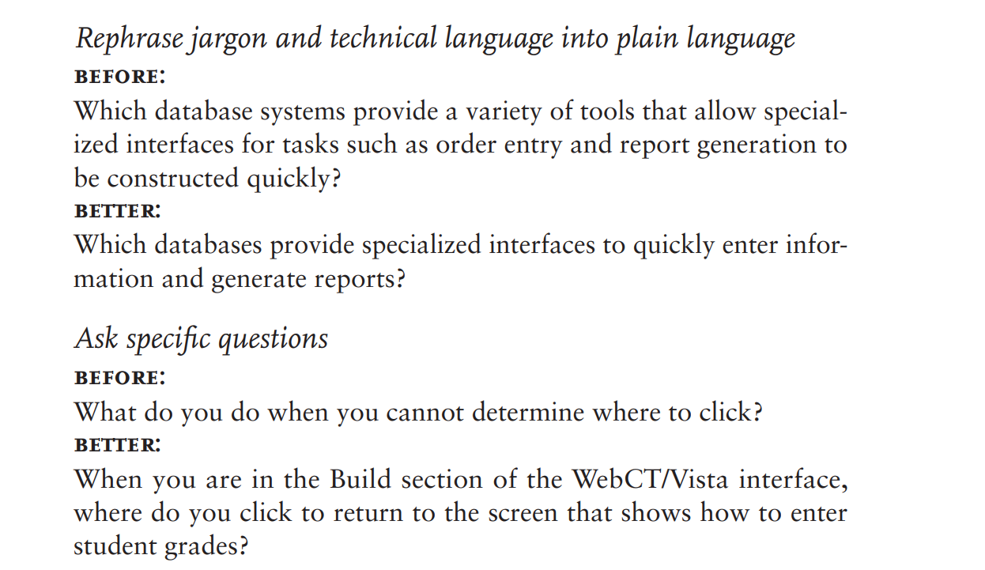
Examples

Slide 14
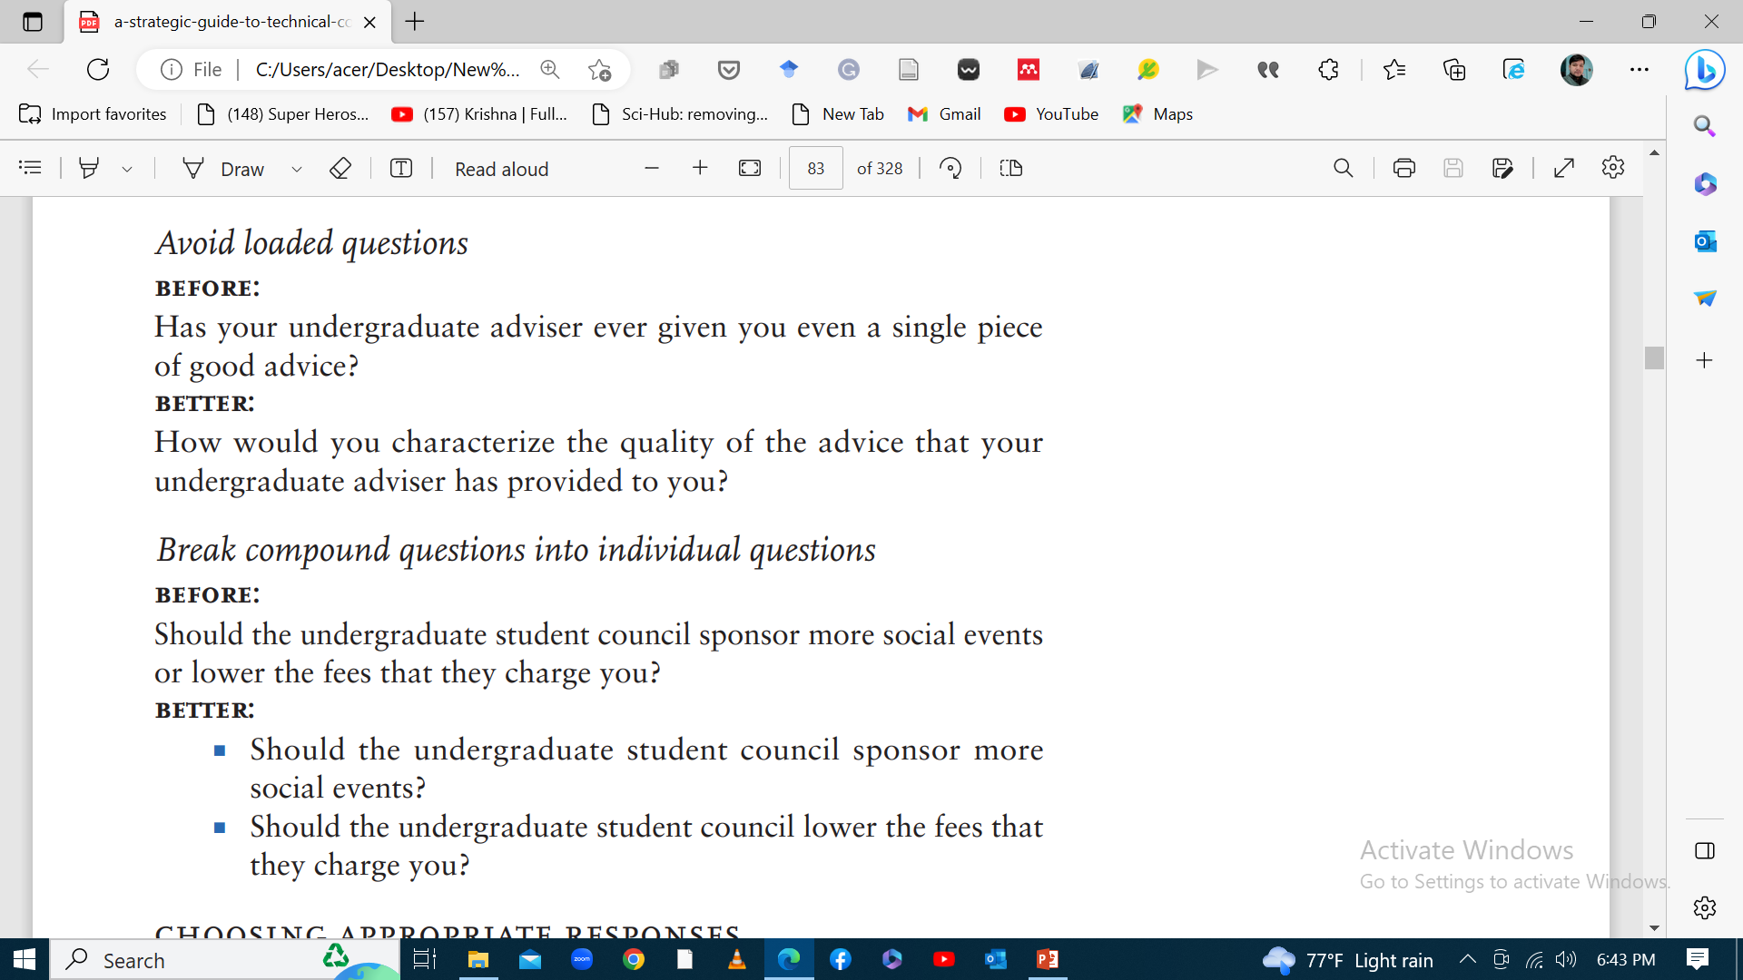

Slide 15
Choosing appropriate responses
Asking good questions is one half of the challenge when you write questions. The other half is creating appropriate responses.
Open-ended questions do not provide a structured response by the very nature of these questions.
Responses to closed ended questions can take the following forms:
Yes/no answers
Rating scales
Comparative rating scales
Category scales

Slide 16
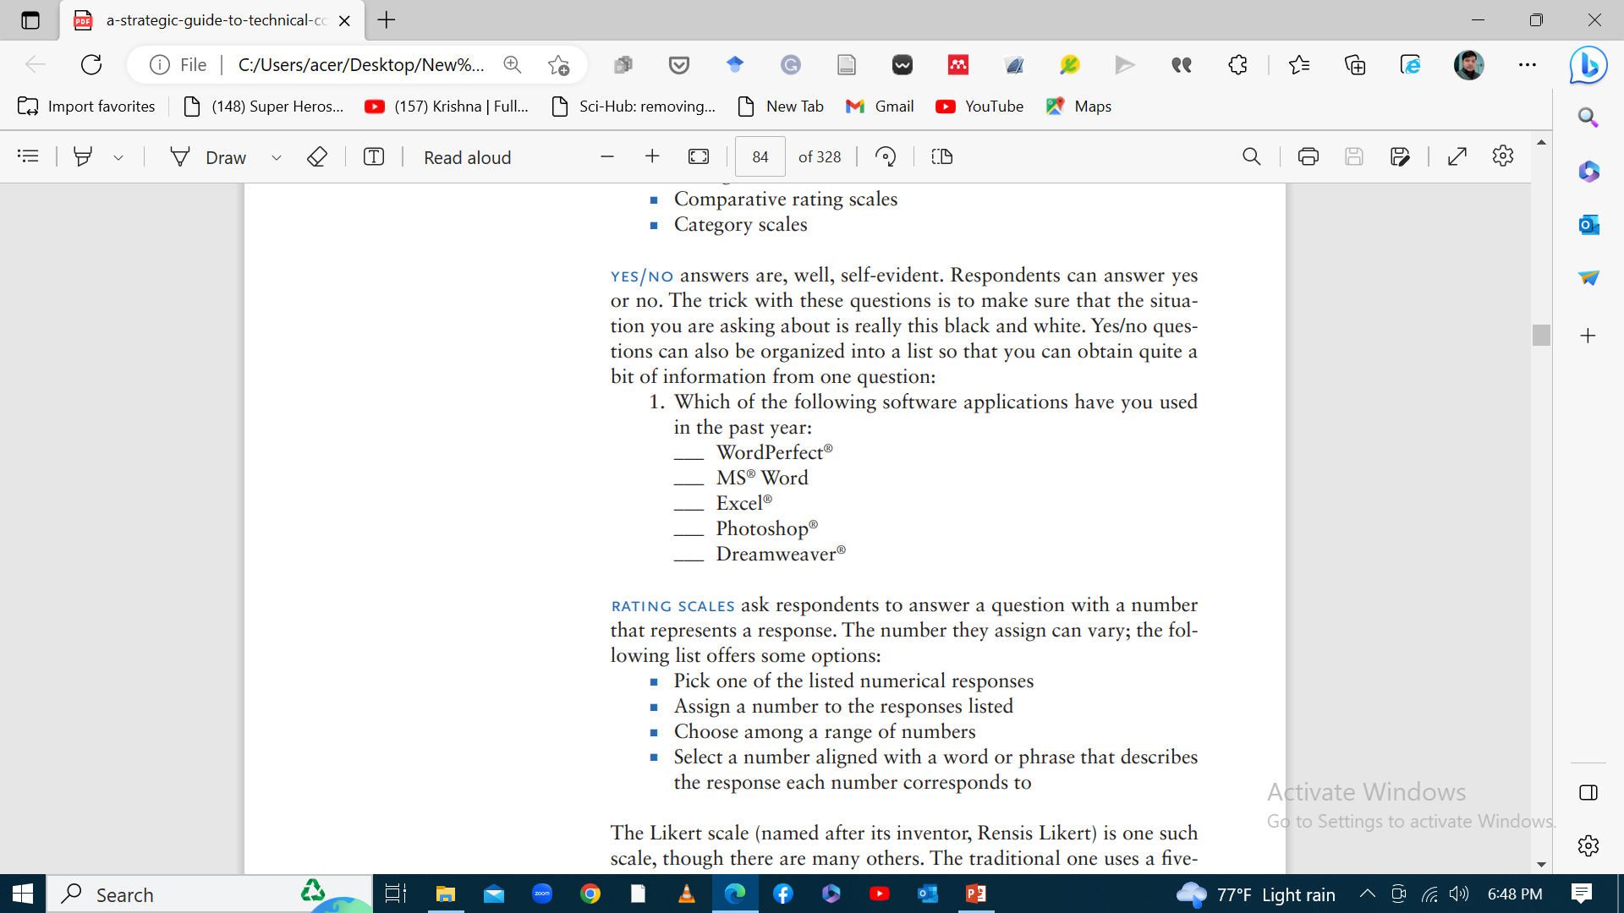
Examples

Slide 17
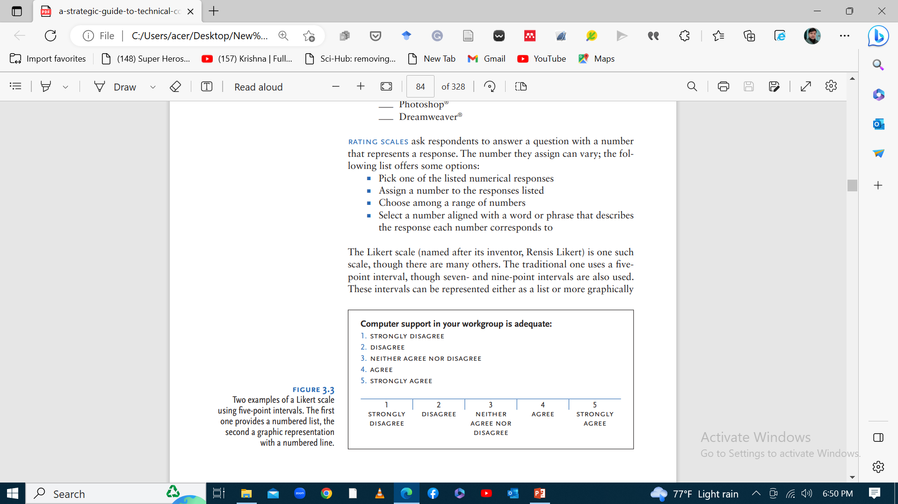

Slide 18
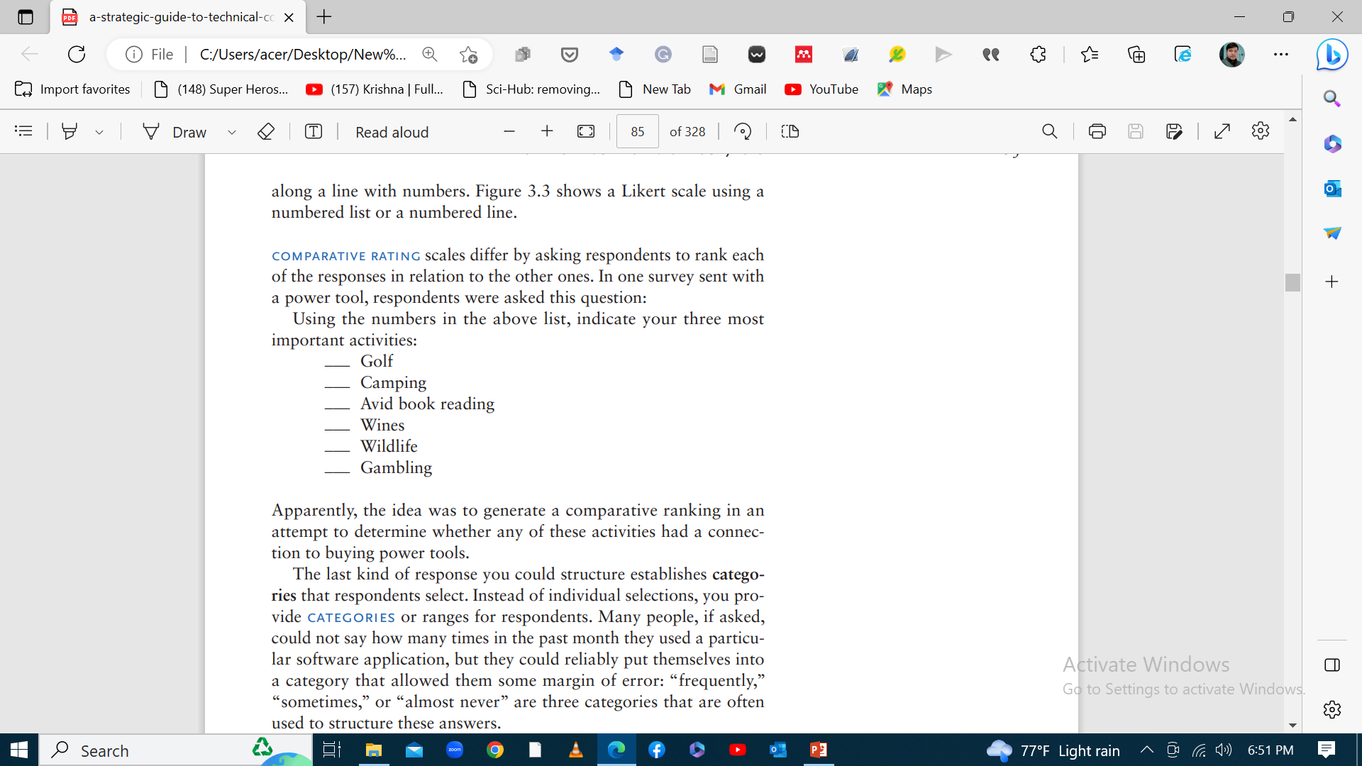

Slide 19
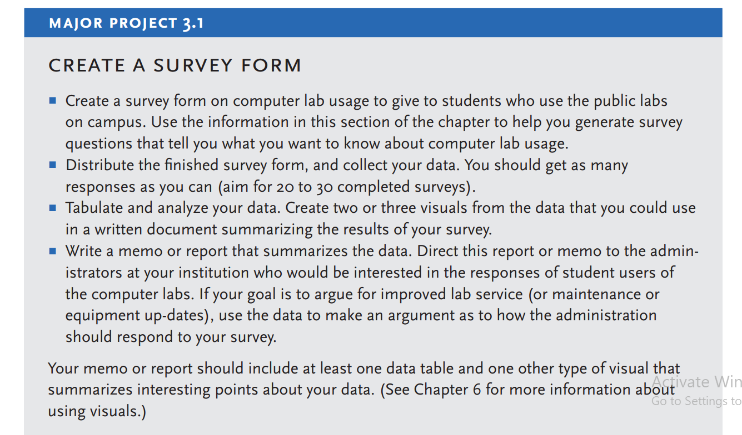

Slide 20
Secondary Research: Finding print and online sources
Depending upon what type of technical document you are writing, you may need to do some library or print research on your subject.
Writing a laboratory report based on a series of experiments, need to investigate further research on aspects related to the topic of experiments.
If you are creating a software manual to fill a market function, you might examine recently published existing manuals to pick up some strategies or tips about what to do or not to do.

Slide 21
..
If you are writing a white paper on a new electronic device, you might visit the Internet to search for competitors’ products that you can use as a comparison with your company’s device.
Examples of well-written white papers about similar devices that may work as model, or consumer chat sites that evaluate and comment on similar products that may give you useful perspectives on what your readers may like or dislike about such items.

Slide 22
..
Libraries are better stocked with useful sources and information.
Many of the technical communication journals have their online issues , and many educational collections carry these contributions.
You can search full-text article from your computer and download a pdf to read on screen or to print off a paper copy.

Slide 23
Conducting an effective search for sources: Library and internet
Finding useful information depends on the keywords that you select to use in your search.
To improve the chances to name your subject matter correctly in the search, generate a list of words that you associate with the topic.
List as many synonyms for each word as you can think of.
A subject directory can help you think of subcategories related to your broader topic.
You can also browse or use keyword searches at the library.

Slide 24
…
To narrow your search, combine two or three key words to focus and qualify the sources that show up on your screen.
You may narrow your search by specifying what you don’t want.
Librarians can shortcut your search time by directing you to the right subject headings, and by pointing out the location of various types of sources.

Slide 25
Assessing the Credibility of your Sources
1. Publisher
2. Author
3. Currency
4. Evidence
5. Slant/ viewpoint

Slide 26
Citing and paraphrasing researched sources
When you encounter a phrase, sentence, paragraph written by someone else what you would like to repeat it exactly, you should quote it.
Quotation means copy the passage word for word, and place it between quotation marks or if it is longer than four lines, set it off in a block quotation.
Note that the long passage is indented to the right and the shorter phrases are contained in quotation marks.
It is important to cite sources, to tell where a quotation came from.

Slide 27
Types of information that you should document:
Statements of opinion
Claims that can be argued
Sources for statistics
Research findings
Examples
Graphs
Charts
Illustrations

